Slide 1
Advanced Software Engineering Practices

Slide 2
Security Seminar

Slide 3
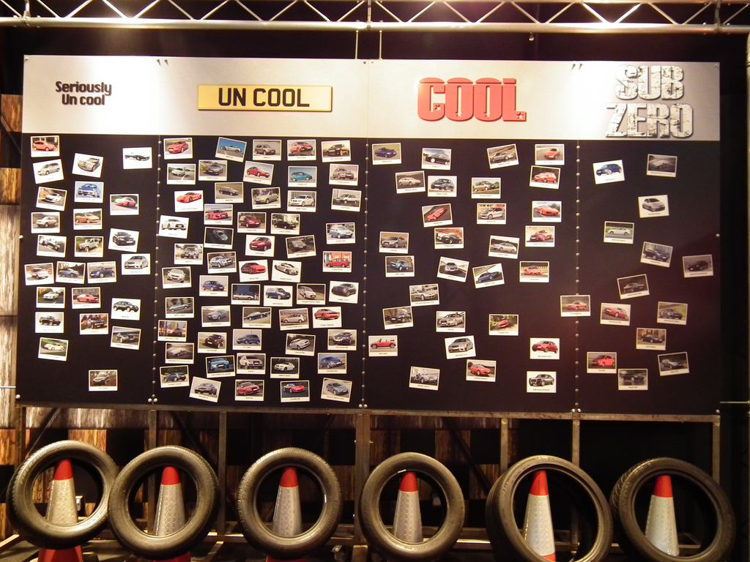
Retro

Slide 4
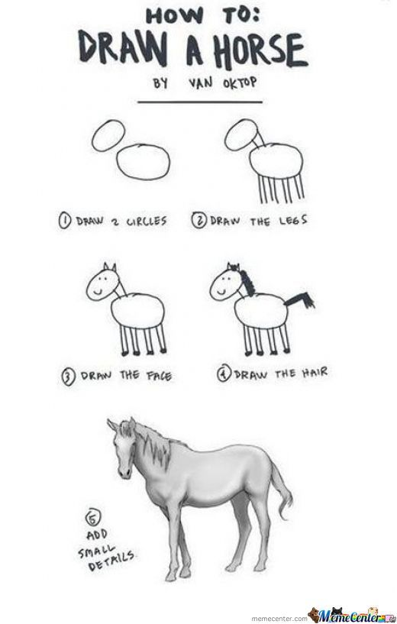
Steps
Assessment Scope – what do we care about
System Modeling – decompose the software
Identity Threats – who will target you and why
Identify Vulnerabilities - how will they target you
Examining the Threat History
Evaluation or impact on the Business
Developing a Security Threat responsible Plan !

Slide 5
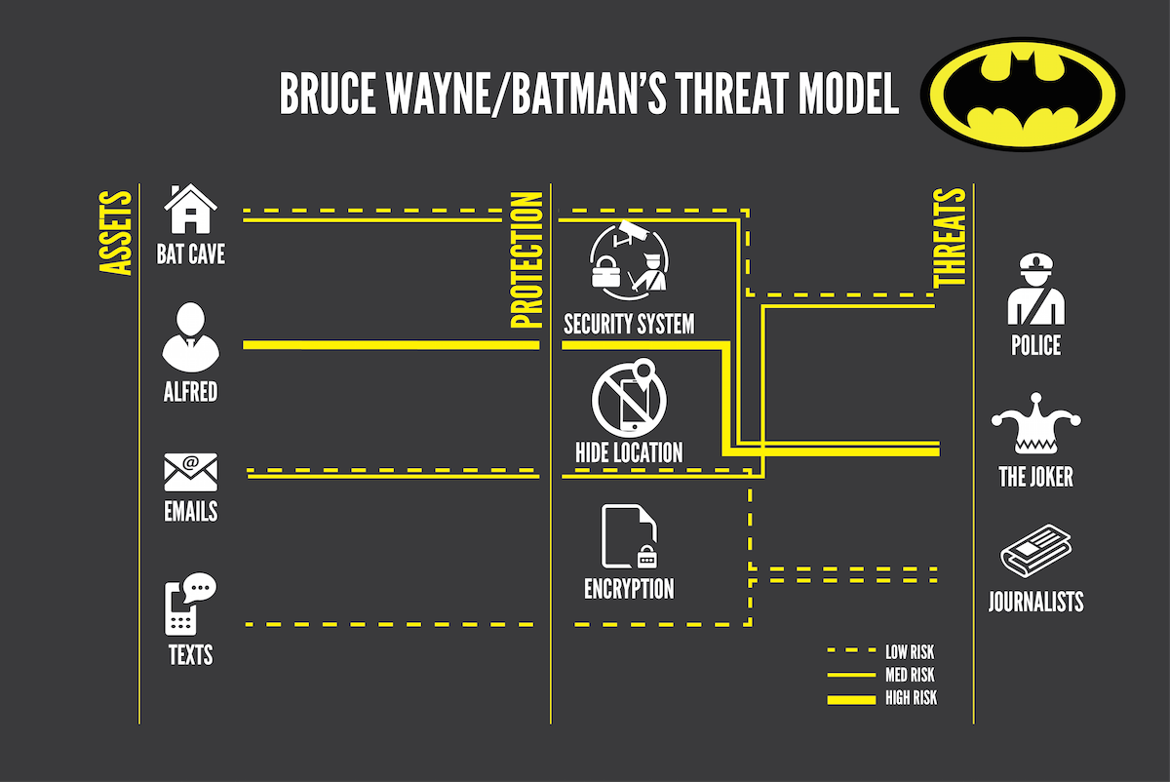
Example:
Notes:
Here's how batman did it and we all know batman can defeat superman 1v1 because he is always prepared.
But Batman also lifes by threat modeling and even you do it daily. A simple thing like not eating garlic before a date with catwoman or not turning on the boost of his batcar right before intersection are thing batman and you do every day.
It can be used for both security and accidental failures.
Threat modeling is a planned activity for identifying and assessing application threats and vulnerabilities
OTHER THINGS BATMAN MIGHT NEED TO THINK ABOUT in terms of Security and Failure

Slide 6
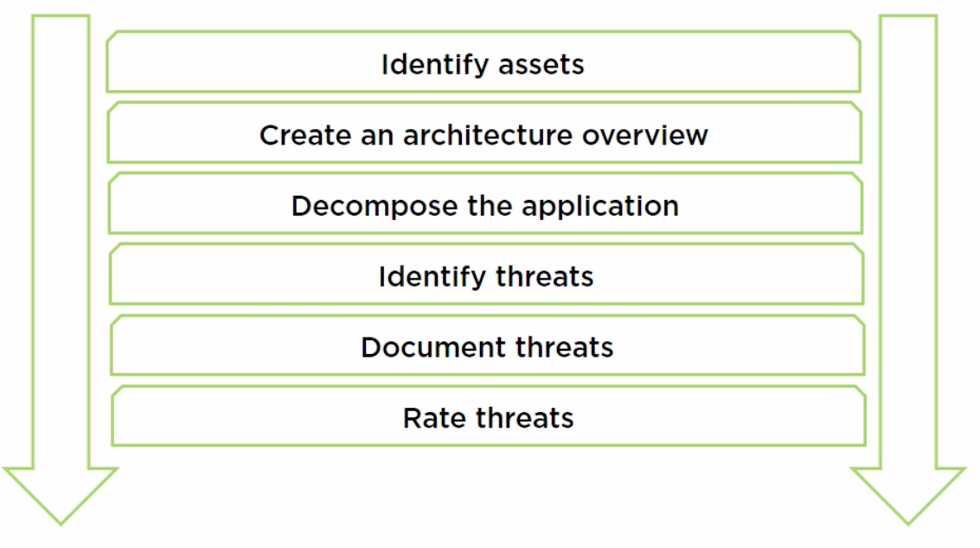
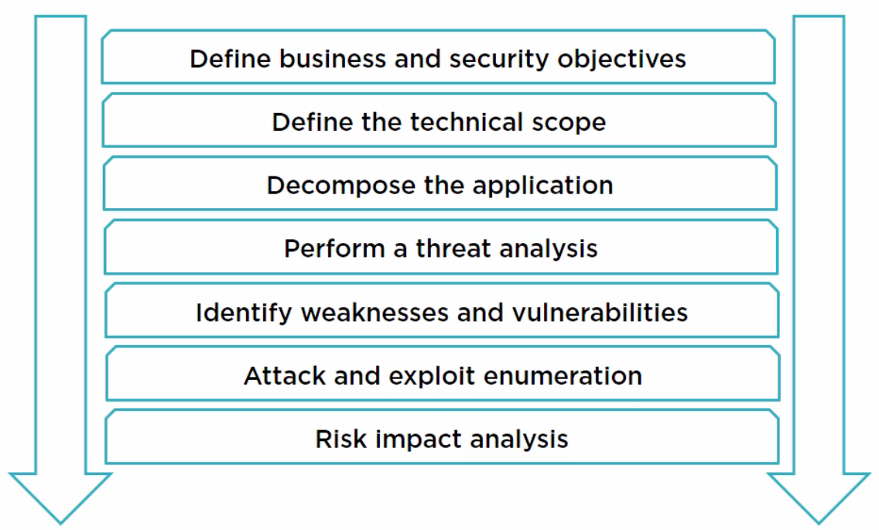
STRIDE VS PASTA
Notes:
Data flow diagram
Example
| (auth)
| 🔄
[web browser] 🔄 (web server)🔄| pictures |
| 🔄
| (verify)

Slide 7
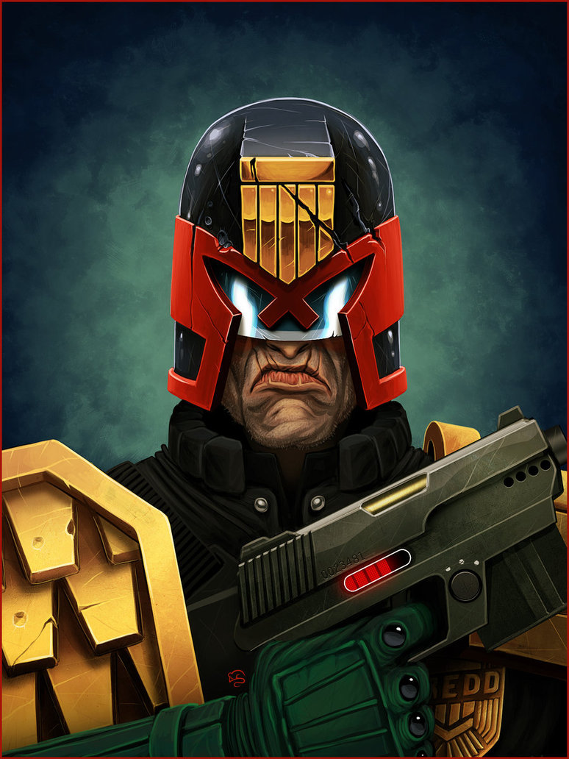
Damage Reproducibility Exploitability Affected Users Discoverability = DREAD
None = 0 Low = 1 Medium =2 High =3
(D+R+E+A+D)/5 = RISK
Is RISK > 1:
Fix NAO
Is RISK <1:
FIX TOMORROW
(DreaD-D)

Slide 8
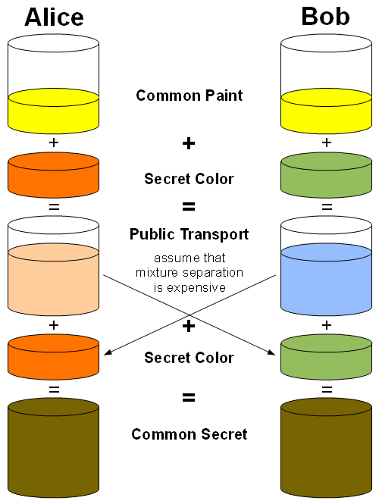
Secure Communication Example

Slide 9
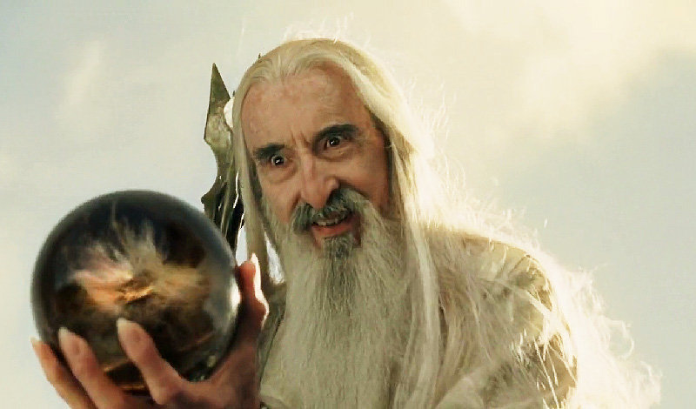
Man In The Middle

Slide 10
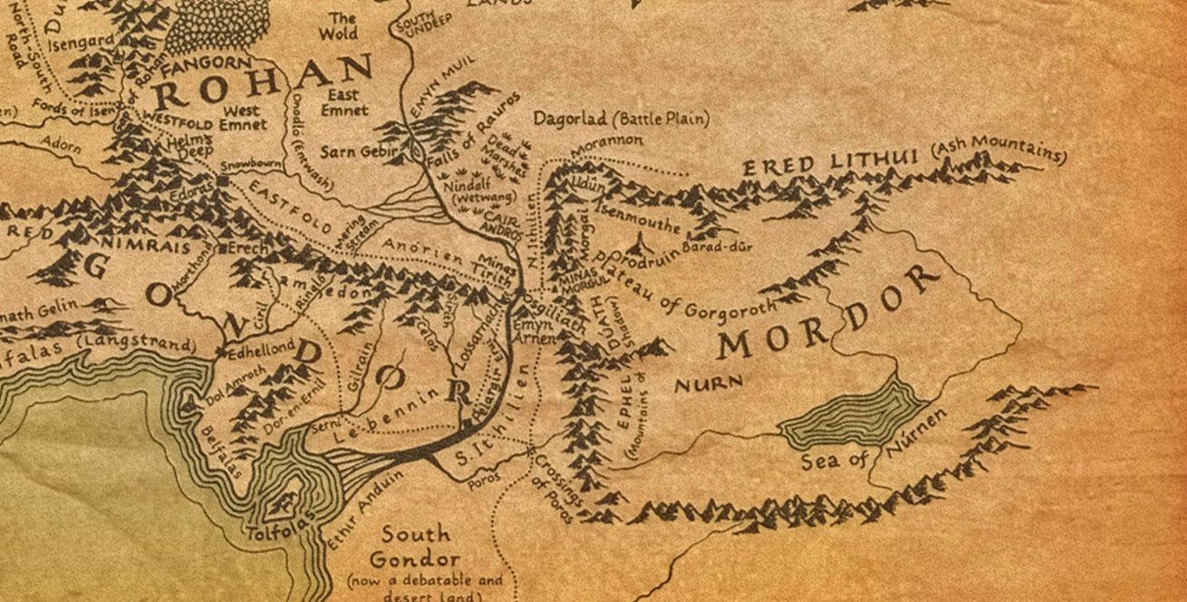

Slide 11
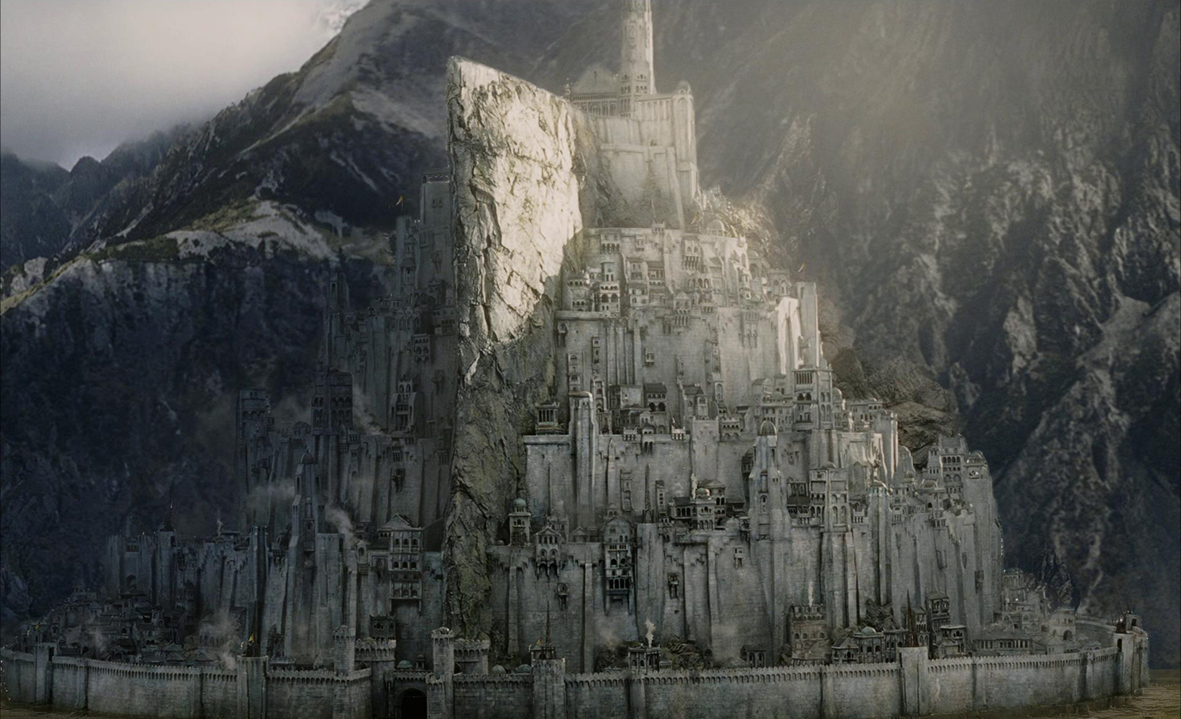
Minas Tirith

Slide 12
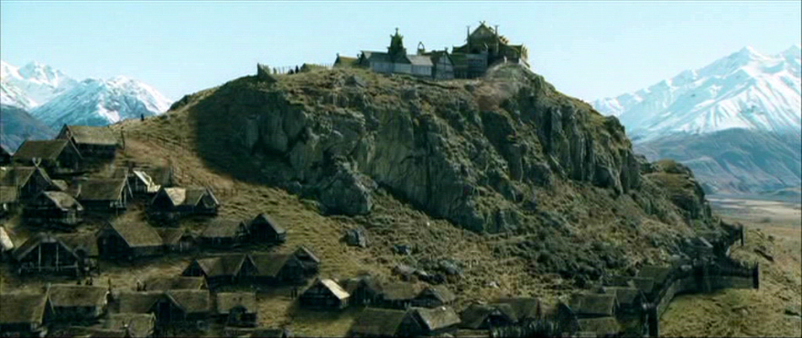
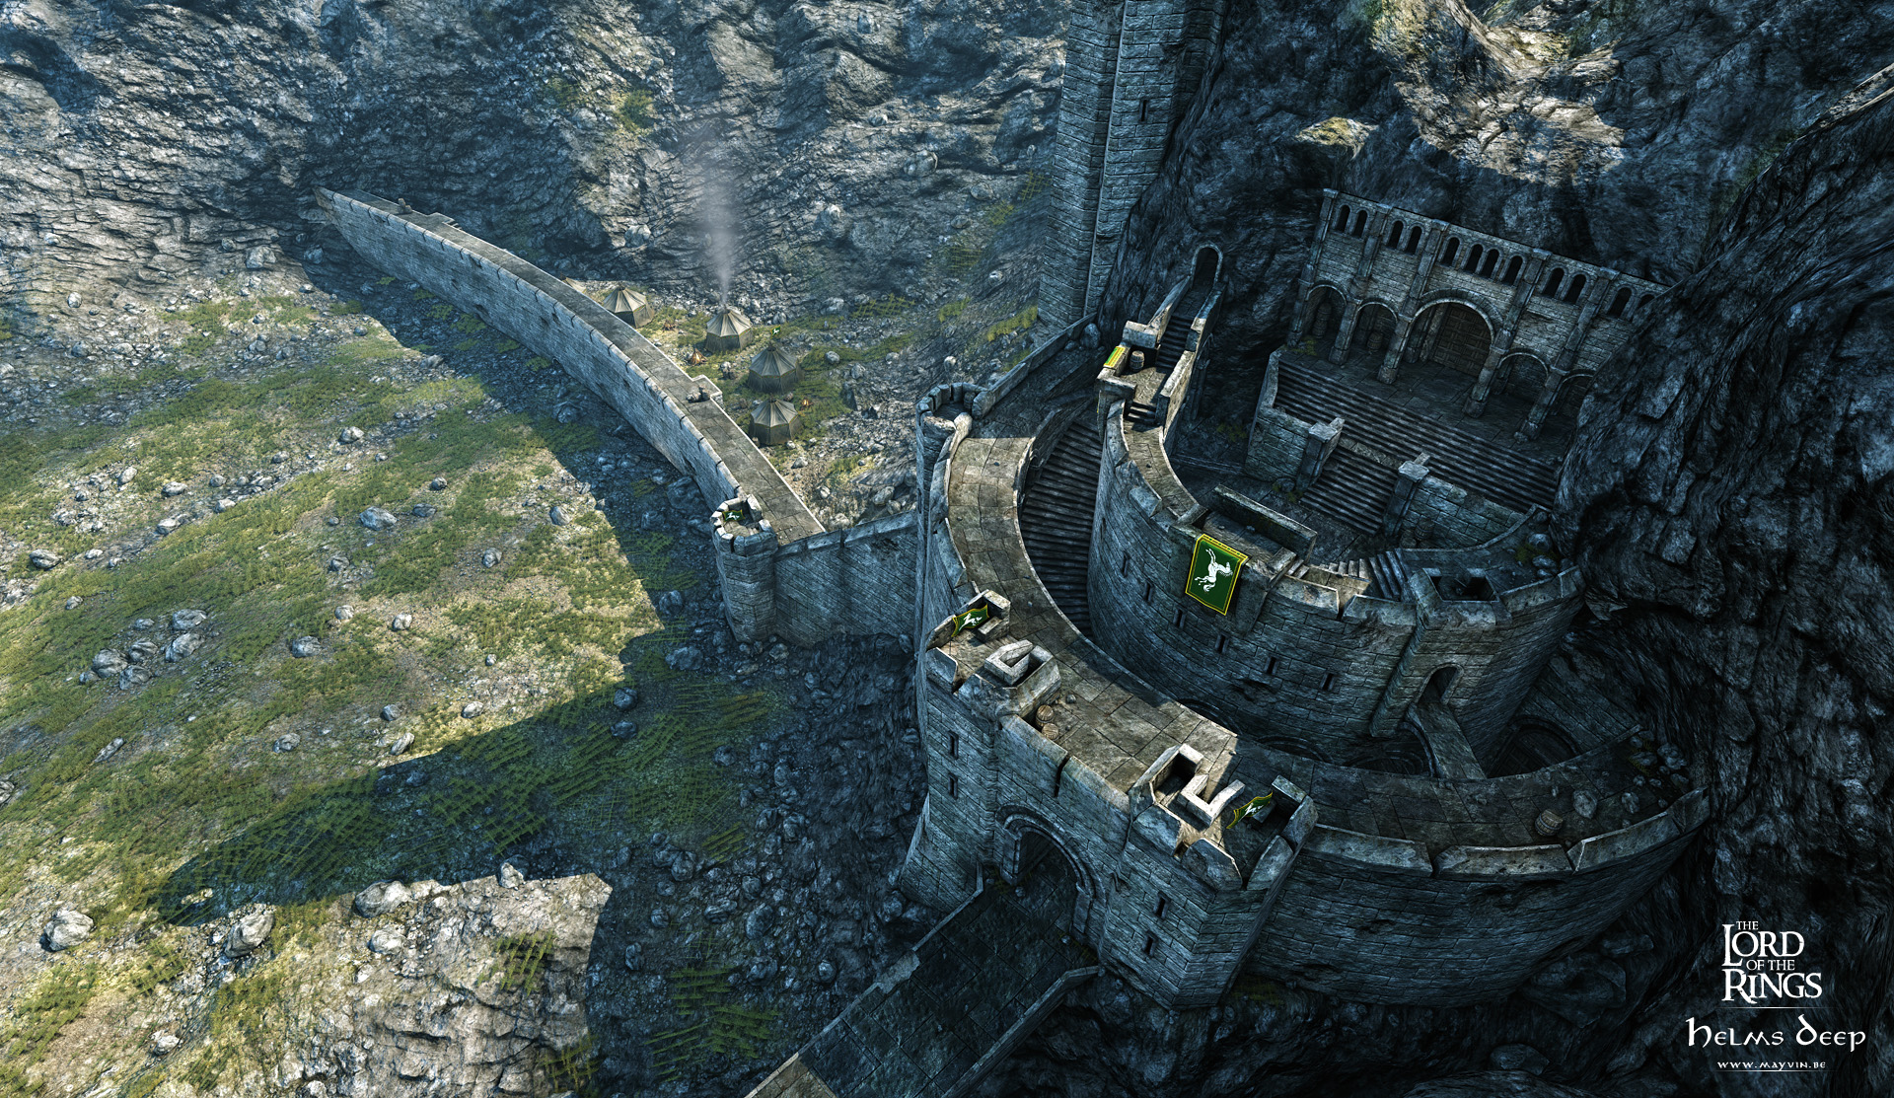
Edoras/Helms Deep

Slide 13
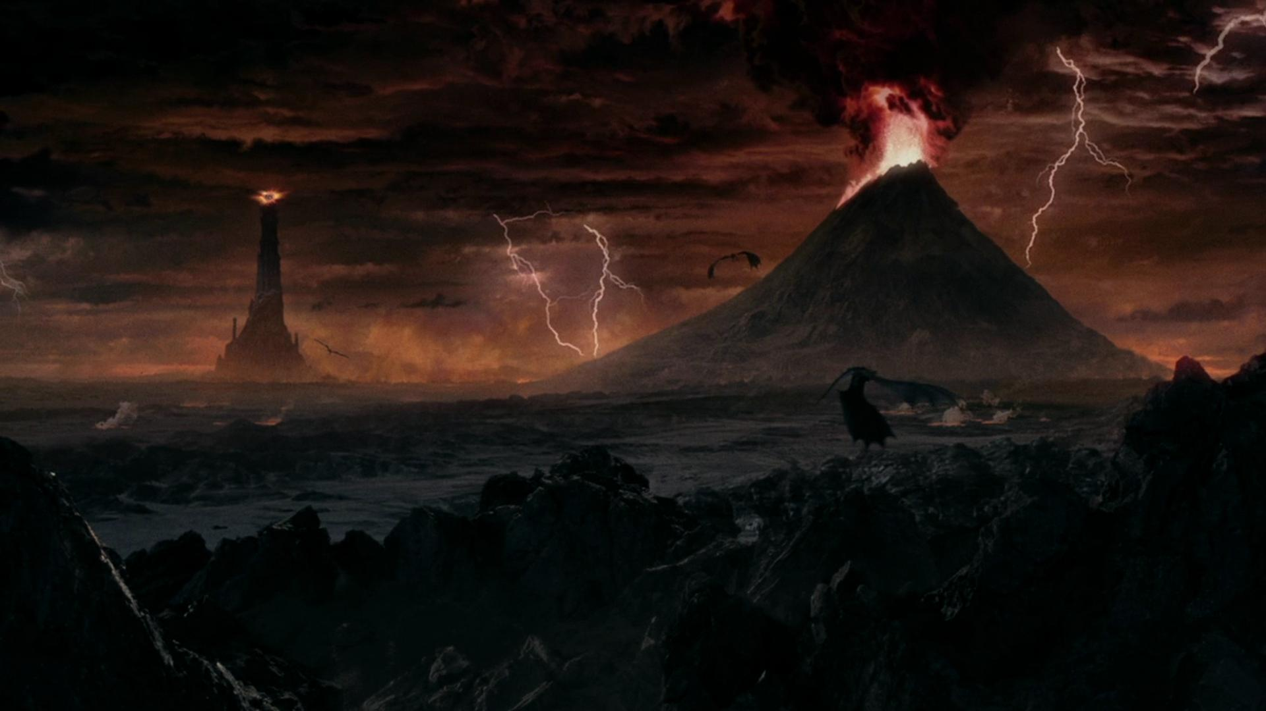
Mordor

Slide 14
Communication
Gondor and Rohan are allies against Mordor
Mordor has spies in Gondor and Rohan
Gondor has spies in Mordor
Rohan has spies in Mordor
The spies need to be in constant communication with their countries
In most cases the information sent is not vital but should never end up in the enemy's hands
During war the information should be delivered 100% of the time

Slide 15
Real World References
Gondor -> API -> multiple walls to reach the end point which in turn will provide you with information
A hacker hardly can hit the API
A developer hardly can hit the API
Rohan -> Data Centre -> The information is the value
The data can’t be replicated because its too much
The backup center is very far away
Mordor -> Service provider -> constant connections flow in and out of the location from multiple entry points.
So many wholes in the firewall that it almost doesn’t matter

Slide 16
STRIDE VS PASTA
Notes:
Data flow diagram
Example
| (auth)
| 🔄
[web browser] 🔄 (web server)🔄| pictures |
| 🔄
| (verify)

Slide 17
WHAT DO NAO?!
Threat model for 15min
3 teams Present for 2-5min each
Everyone OBLITERATE the presented Ideas
Have 10min to fix your ideas
Other teams Presents for 2-5min each
Everyone OBLITERATE the presented Ideas
Mix the teams into 3 and Fix
Last chance !

Slide 18
Advanced Software Engineering Practices

